Slide 1

M3 Presentation:
Football Player Management
Team 11
Members:
Cao JiaPing, 3rd Year, SUSTech
Liu Xiaoyu, 2nd Year, SCU
Yang Junyi, 2nd Year, HUST
Zhu Jiongli, 2nd Year, XJTU

Slide 2
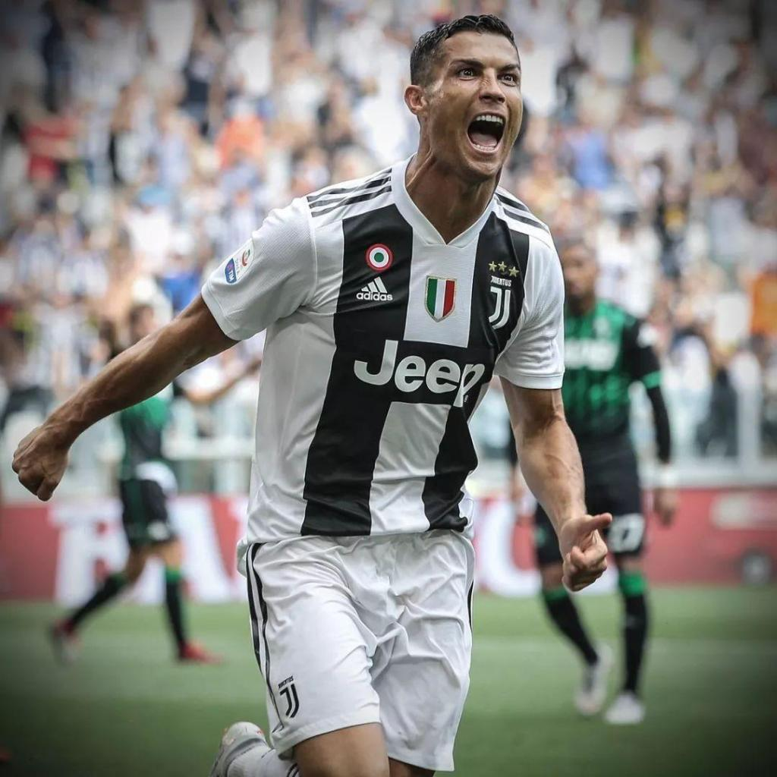
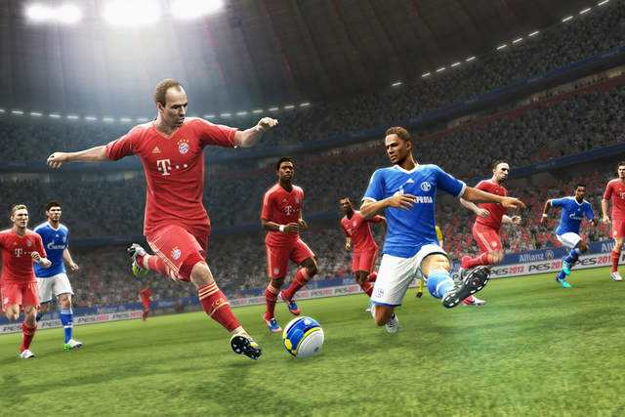
introduction
We(esp YJY) love football!
La Liga / Premier League / UEFA Champions League...
extraordinary shots
first class clubs & teams
celebrities

Slide 3
Who can replace C. Ronaldo?
and others?
“Scouts”(球探)

Slide 4

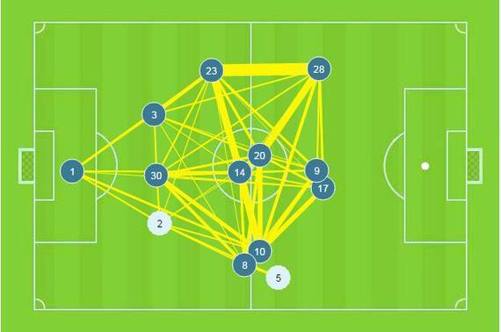
motivation
Applying big data analysis?
For individuals: Definitely get comprehensive understanding of their favorite players.
For clubs: Buy and evaluate their members in an accurate and scientific way.
For business: Companies like Prozone and Opta are making huge profit by doing data analysis on players.
For fun: PC game Football Manager!
For my team: we have an expert & fanatic about football :P

Slide 5
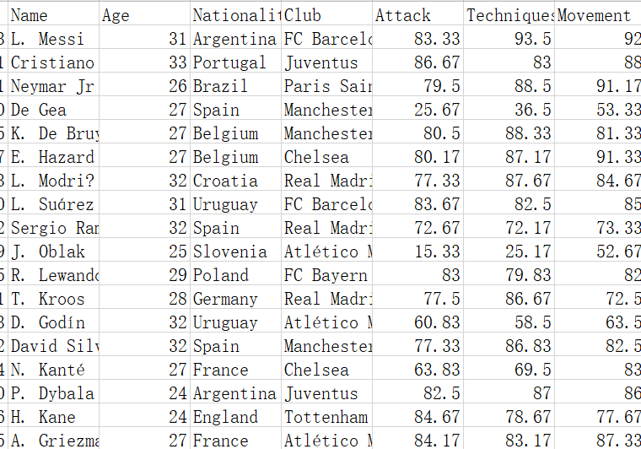
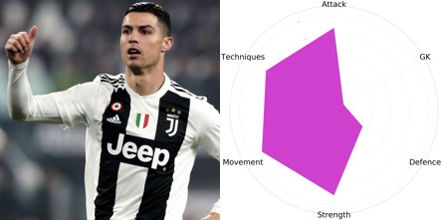
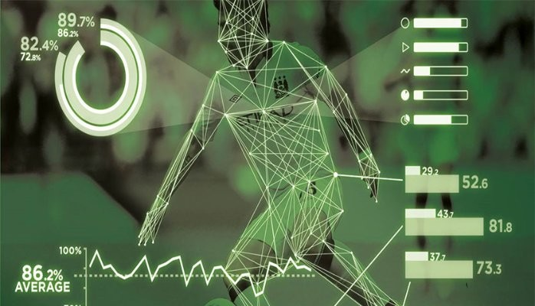
overview
data
source
attributes
scope
football manager data
in .csv format
6D abilities / nationality / club
clean up — select — merge
additional data:
the reputation / potential of players
top 500 players
and
players from different countries

Slide 6
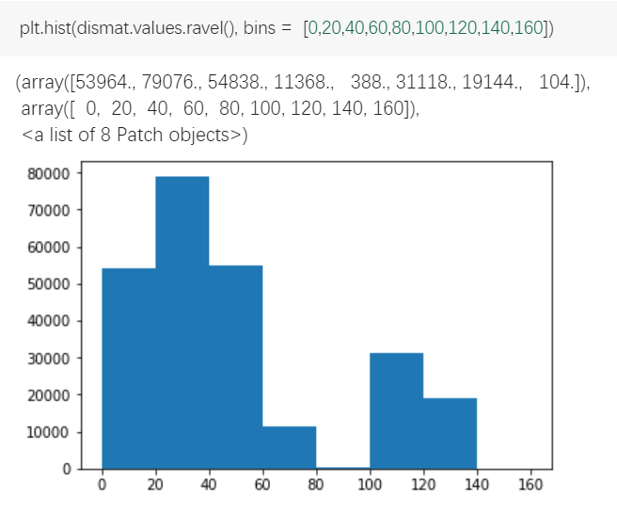
Calculate
dissimilar matrix
a = pd.read_csv('famous-utf.csv', encoding='utf-8')
data = a.ix[:, 'Attack':]
names = a.ix[:, 'Name']
data_with_name = pd.concat([names, data], axis=1)
dismat = pd.DataFrame
(squareform(pdist(data_with_name.iloc[:, 1:])), columns=data_with_name.Name.unique(), index=data_with_name.Name.unique())

Slide 7
overview
expected results
01
Excellent players (with high value) will be close to each other.
Players with similar styles will be close to each other.
02
02
Some players are so unique(excellent) that they will set themselves apart from a cluster.
03
Some teams' degree of homogeneity will be relatively high, which leads to unbalanced performance on the field.
04

Slide 8

results & analysis

Slide 9
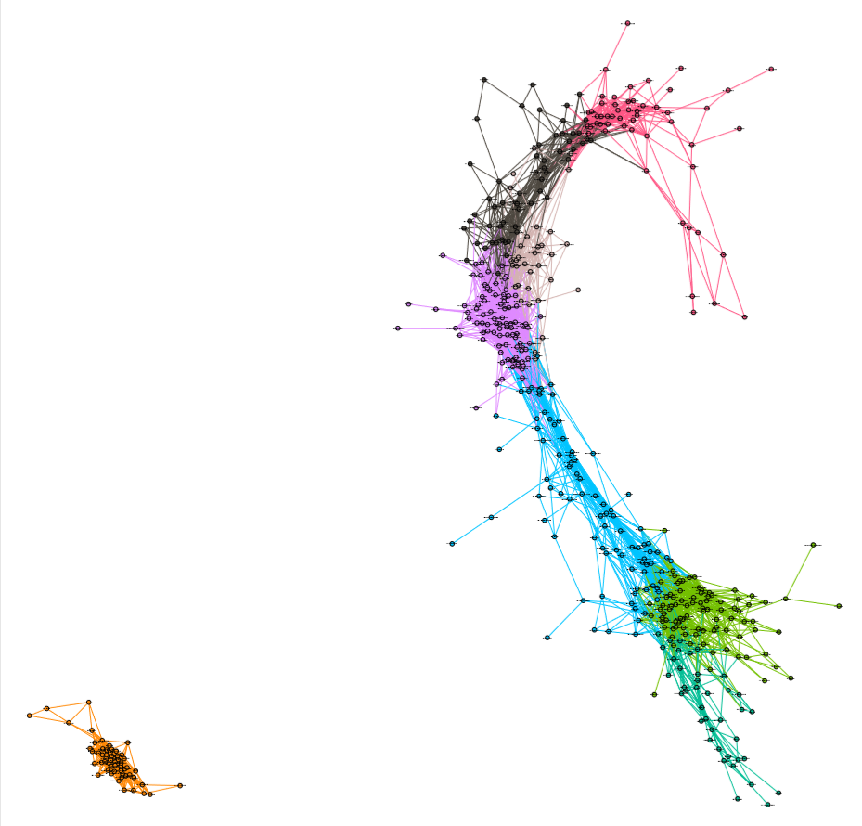

6D abilities
This is an overview.
Players of different roles form different communities.
Goalkeepers stand far away from the others.
Every single player differs from one another.

Slide 10
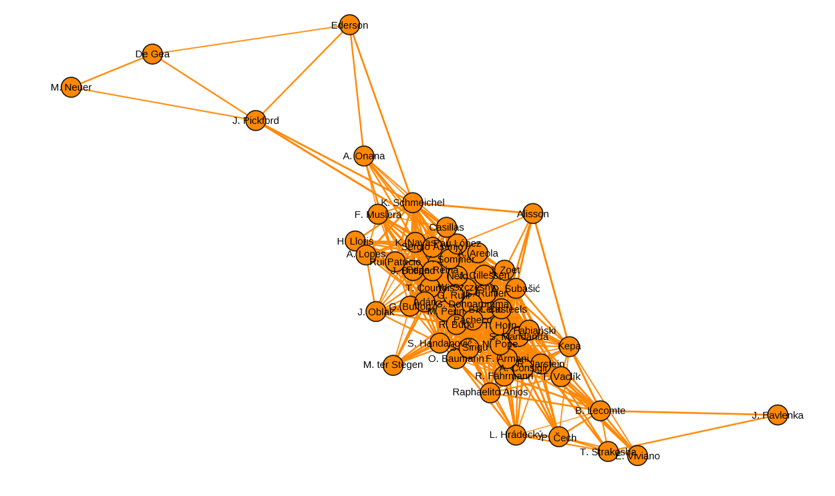
6D abilities（GK）
Click here to play the video
The circled goalkeepers
are distinguished from other ordinary goalkeepers.

Slide 11
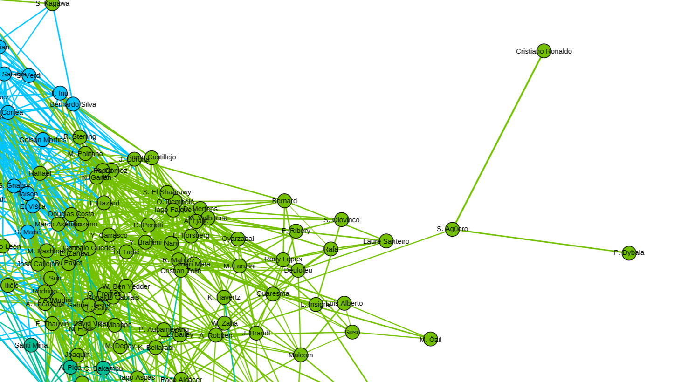

6D abilities
Cristiano Ronaldo is so unique that he is distant from other players. His neighbor – Aguero, is similar in scoring efficiency.

Slide 12
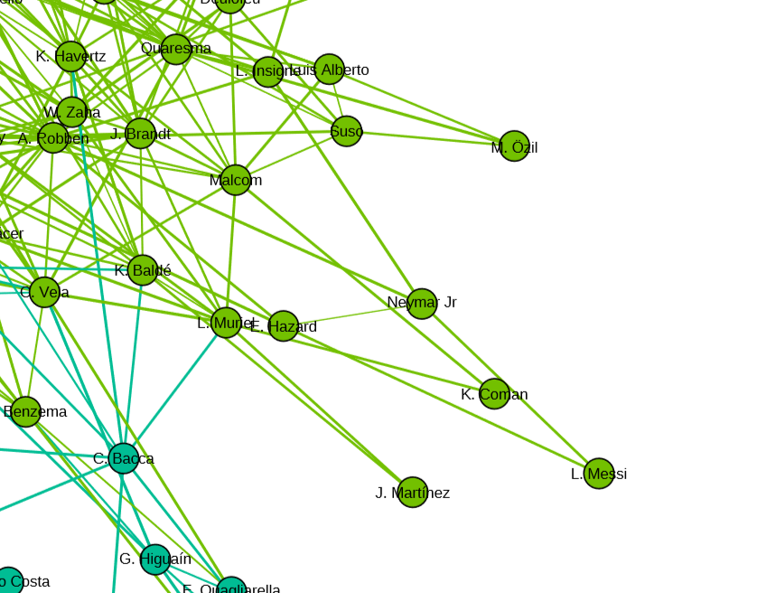

6D abilities
Players in this circle are really good at breaking through.
Neymar, Hazard, Messi even play in a similar style. That’s why they are so close in our graph.

Slide 13

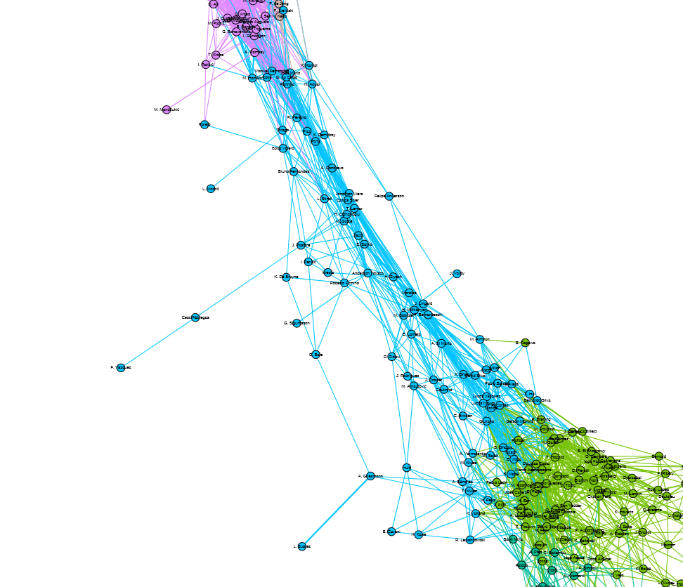

6D abilities
Famous football clubs always avoid homogeneous players playing together.
Homogeneity can be harmful to a team.
For instance, if the attacking line of the team consists of players good at striking, not so good at breaking through, then they will meet obstacles when they have no chance to strike at all.
Look at Liverpool’s attacking line. Mane & Salah are similar, while Firmino plays quite differently.
That’s the reason why Liverpool is so efficient in attacking.
Clubs can use our graph to evaluate their homogeneity.
Roberto Firmino
M.Salah & S.Mané

Slide 14

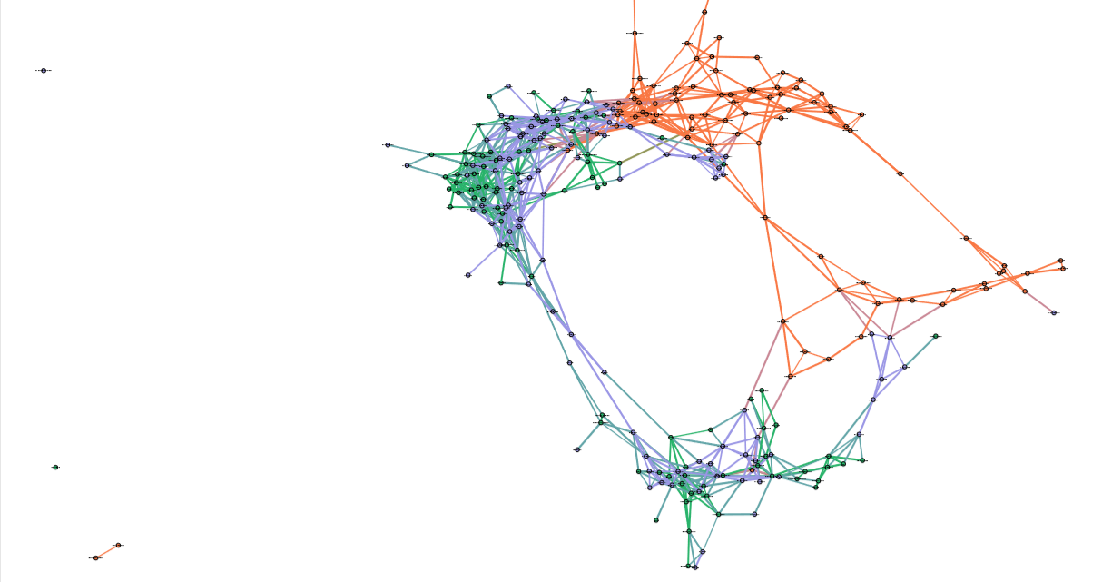
3 countries
China(Orange)
Germany(Blue)
Brazil(Green)
We input all the players of these three
countries, clustering them by their
nationality, and we find that they form
three communities.
Some green and purple dots are mixed together, showing that Brazilian and German players are similar in some aspect.
As for Chinese, only several players can play like Brazilians and German.

Slide 15
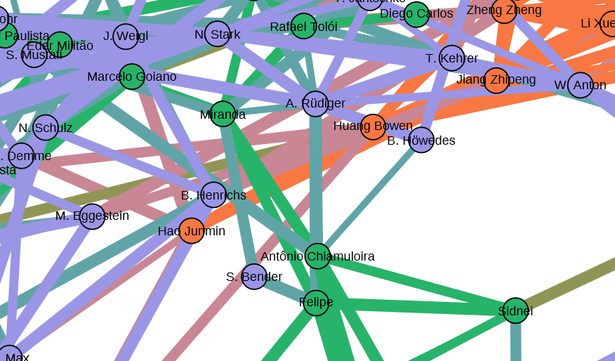
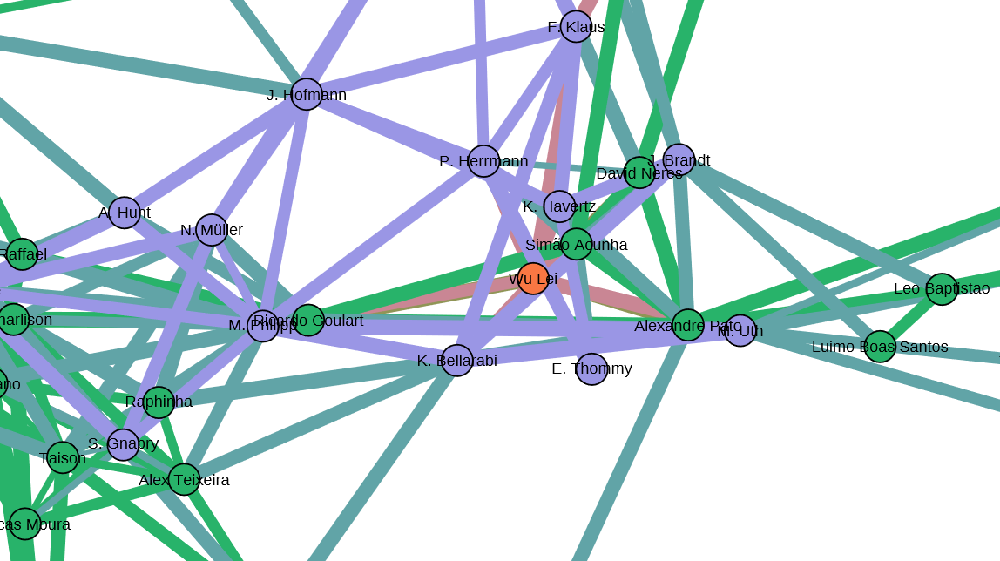
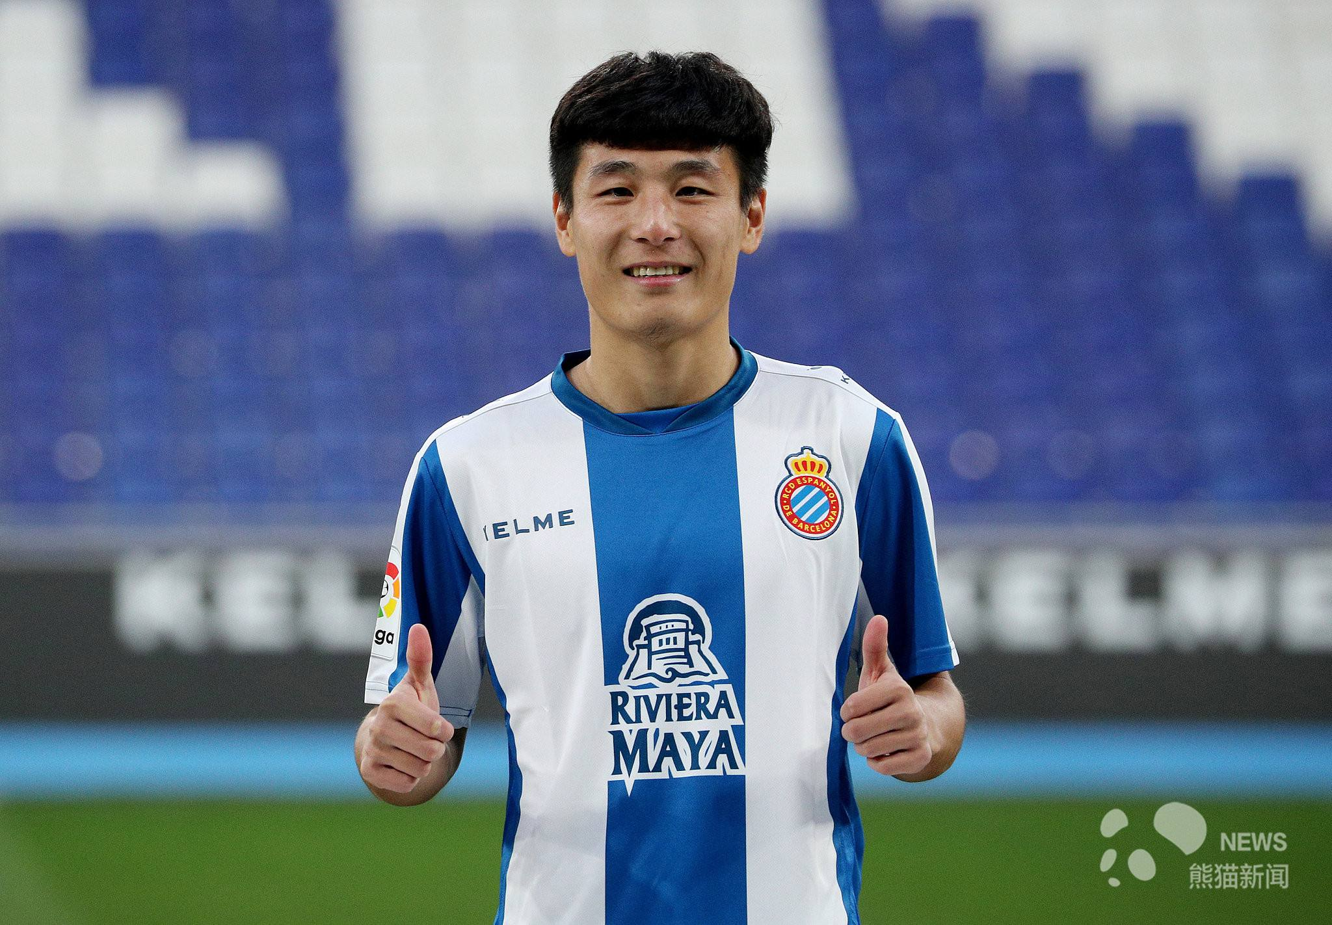


3 countries
Huang bowen 黄博文
Wu Lei 武磊
Hao Junmin 蒿俊闵

Slide 16
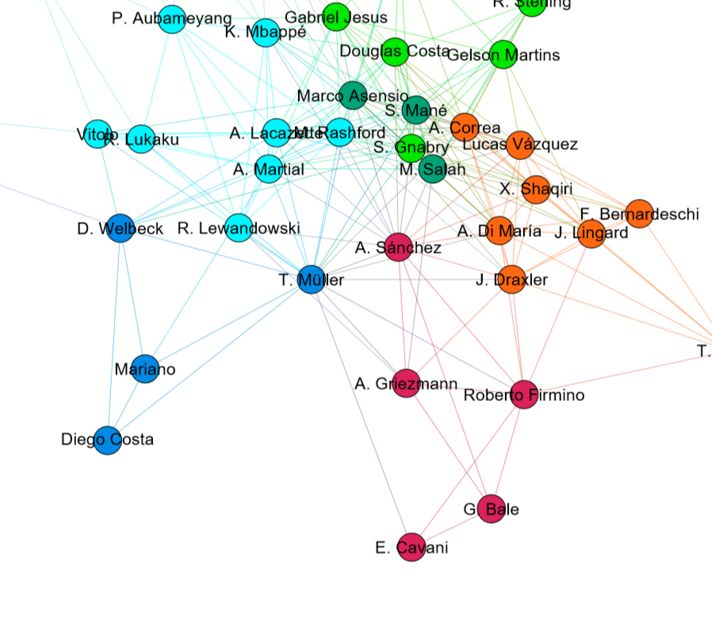
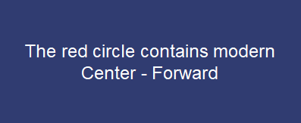
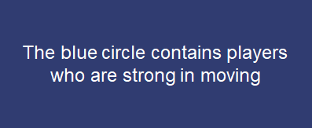
Detailed clustering

Slide 17
New insights
01
Nobody can really replace Cristiano Ronaldo
Clubs usually avoid homogeneity in each line.
02
02
03
It still takes a long way for Chinese players to be better.
If possible, Chelsea should sign Neymar to replace Hazard.
04

Slide 18
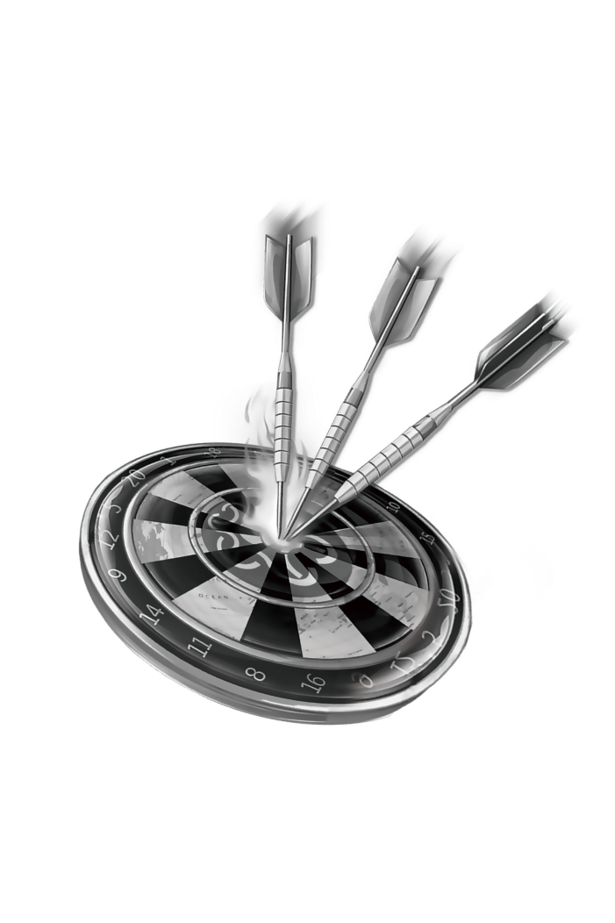
Application：
Achievement Predictor
LAN address:
172.25.104.238:5000

Slide 19
Algorithms
We had also tried some algorithms in order to find more better community partitions.
Markov Cluster Algorithm
Girvan-Newman Algorithm
Community
Detection
Louvain Algorithm

Slide 20
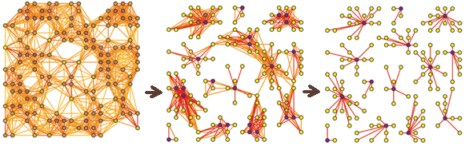
Algorithm
Markov Cluster Algorithm (MCL)
MCL is a repeating process of expansion and inflation.
Expansion spreads flow from each node to make adjacent nodes more likely to be in the same cluster.
Inflation is the contraction of flow, which makes high possibilities higher, low possibilities lower.

Slide 21
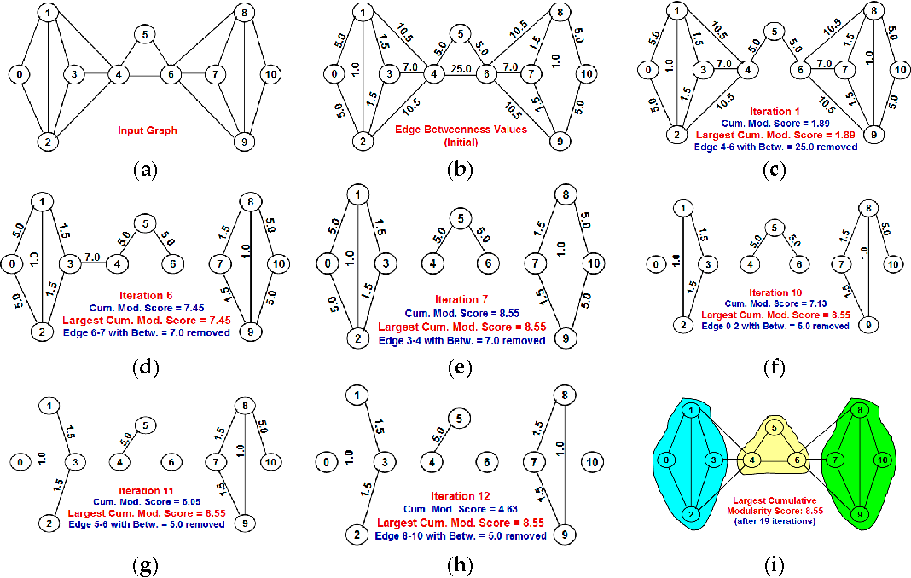
Algorithm
Girvan-Newman Algorithm
Remove the edges most likely between clusters step by step.
An edge will be removed if it has the largest number of shortest paths passing through it.
The remaining connected components are the communities.

Slide 22
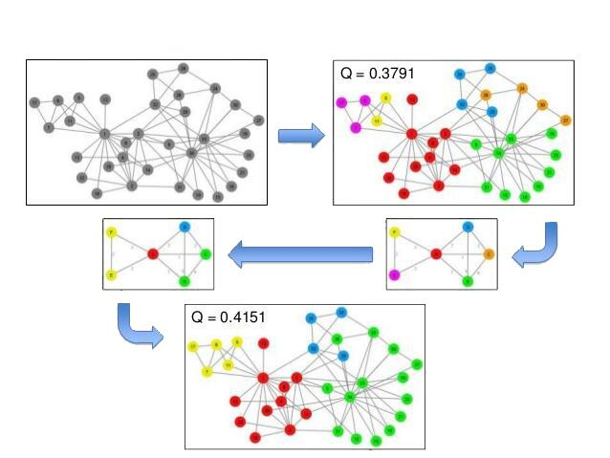
Algorithm
Louvain Algorithm
Use “Modularity” to evaluate the community quality.
Find partitions that optimize modularity on the current graph.
Aggregate nodes in the same partition into one node, and repeat the previous process.

Slide 23
Algorithm
Experiments
Our goal is to find the best community partitions, and we evaluate the communities by modularity, also manually.
We ran all three algorithms on three data sets.
We tried a series of thresholds to eliminate edges, and the parameters which can maximize modularity are used.

Slide 24
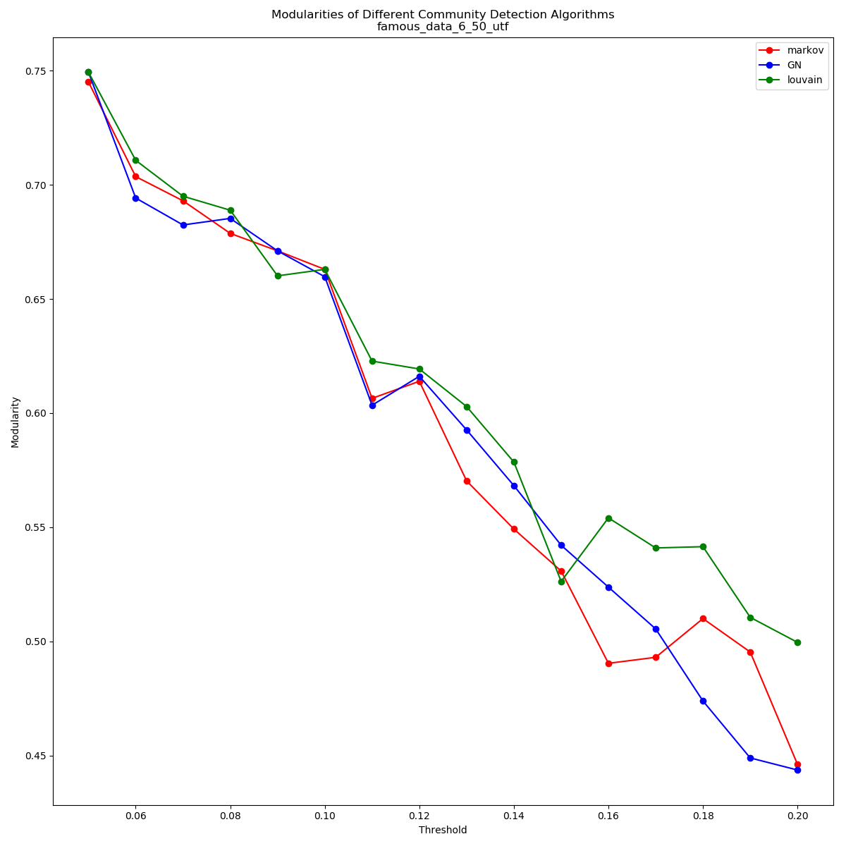
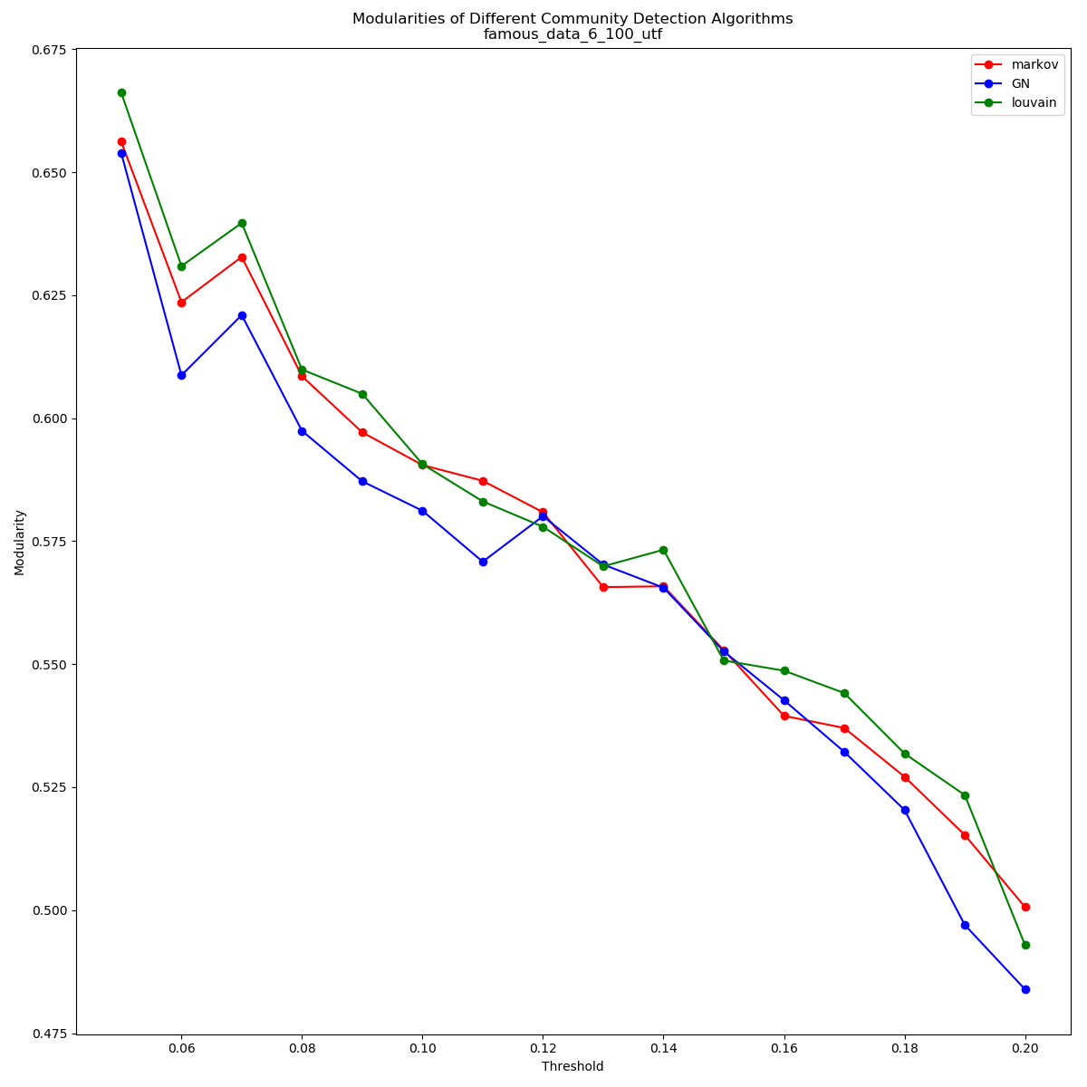
Algorithm
Top 50&100 soccer players with the highest salary
The data sets contains all kinds of soccer players.
Almost all players have many other players connected by edges.
The modularities of the three algorithms do not have large differences, Louvain is slightly better in most cases.

Slide 25
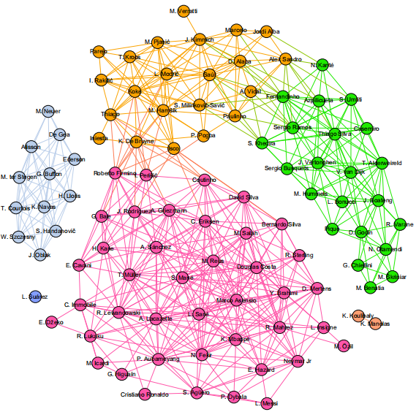
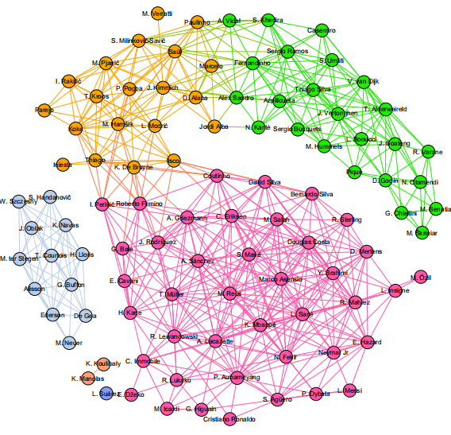
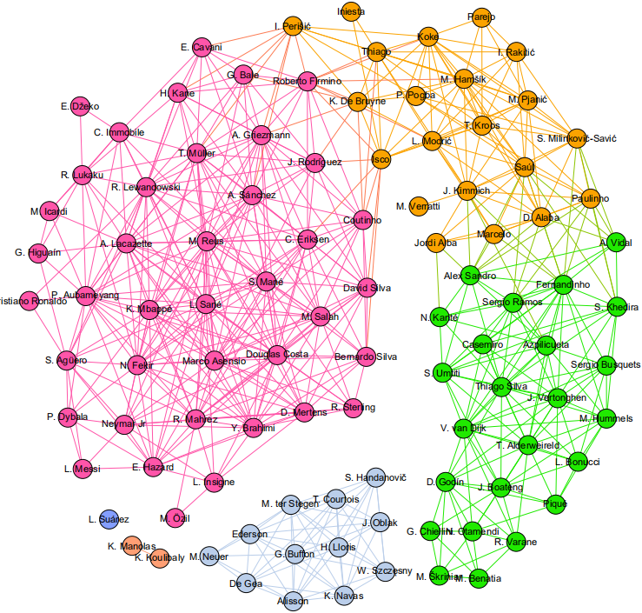
Algorithm
Top 100 soccer players with the highest salary
GN, threshold percentage=0.12, R=3.0, E=3
Louvain algorithm, threshold percentage=0.12
Markov cluster, threshold percentage=0.12
They are almost the same!

Slide 26
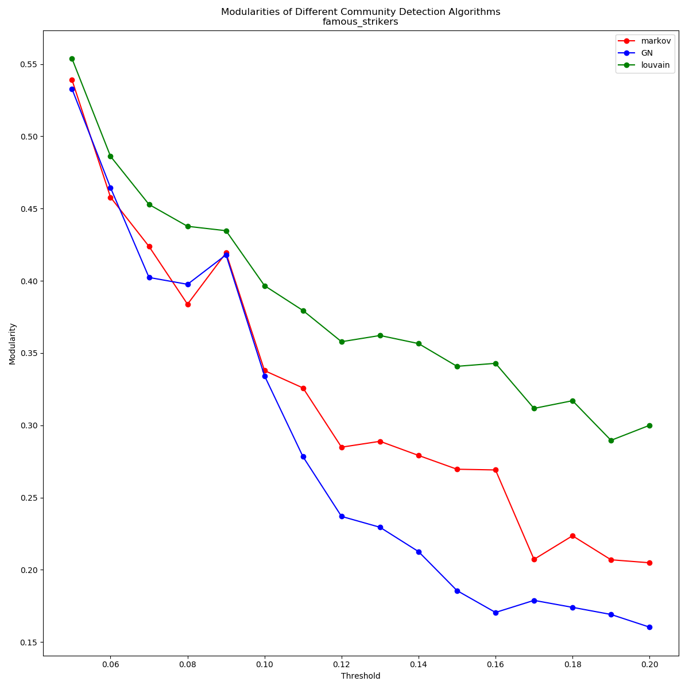
Algorithm
Famous strikers soccer players
The data set contains strikers from a community in previous data set.
Some of the players have very few similar players.
Louvain basically defeated the two other algorithms with much higher modularities.

Slide 27
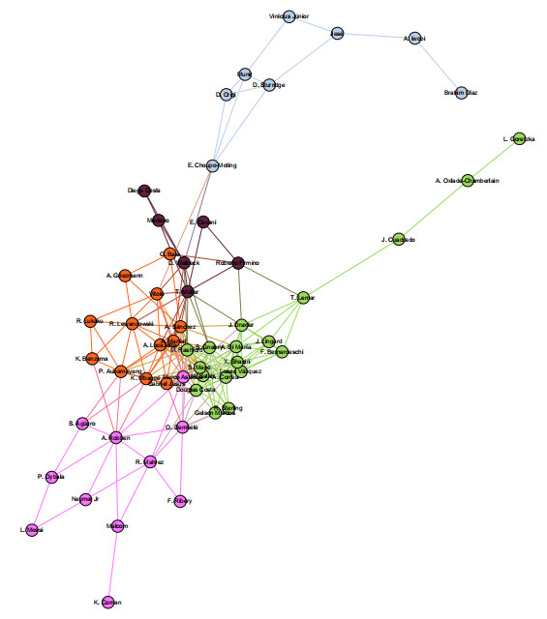
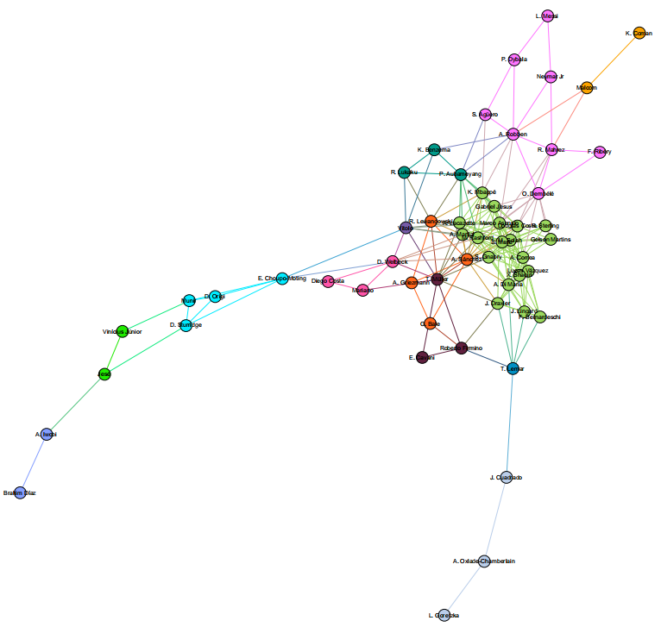
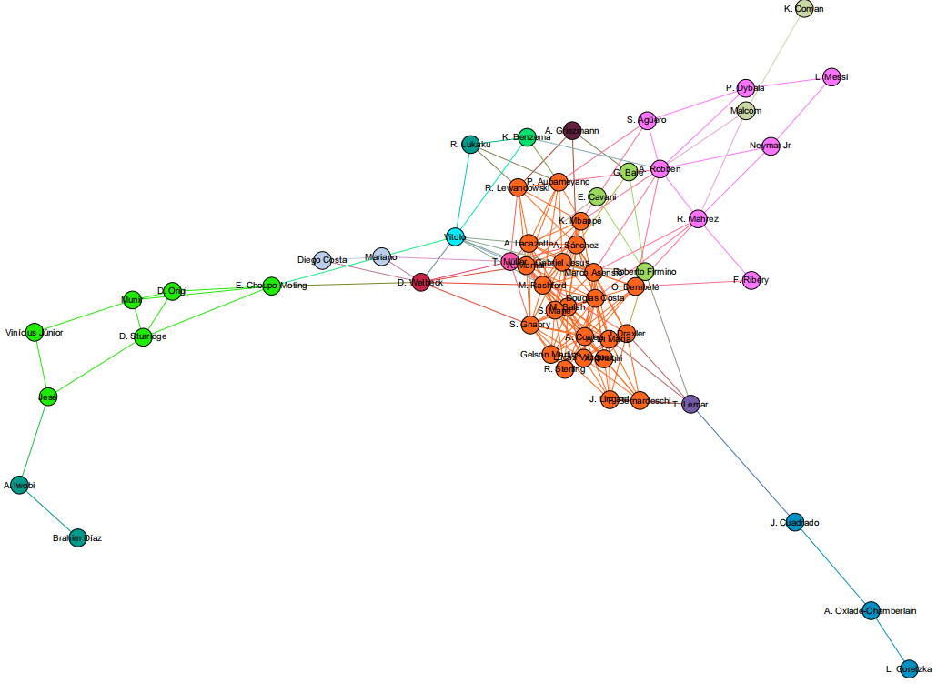
Algorithm
Famous strikers soccer players
GN, threshold percentage=0.12, R=2.5, E=2
Louvain algorithm, threshold percentage=0.12
Markov cluster, threshold percentage=0.12
We can see partitions with higher modularity are also more meaningful communities, without small single node communities.

Slide 28
Algorithm
Conclusions
The performances of the three community detection algorithms on a relatively random and large data set (top salary data set) is about the same.
When the graph has some bridges, relatively unique nodes, unbalanced number of edges among nodes, GN and Markov are more likely to produce small communities in the cracks of some large communities. However, Louvain algorithm still generates balanced partitions.
As a conclusion, Louvain algorithm produce the best communities evaluated by modularity at most of the time.

Slide 29

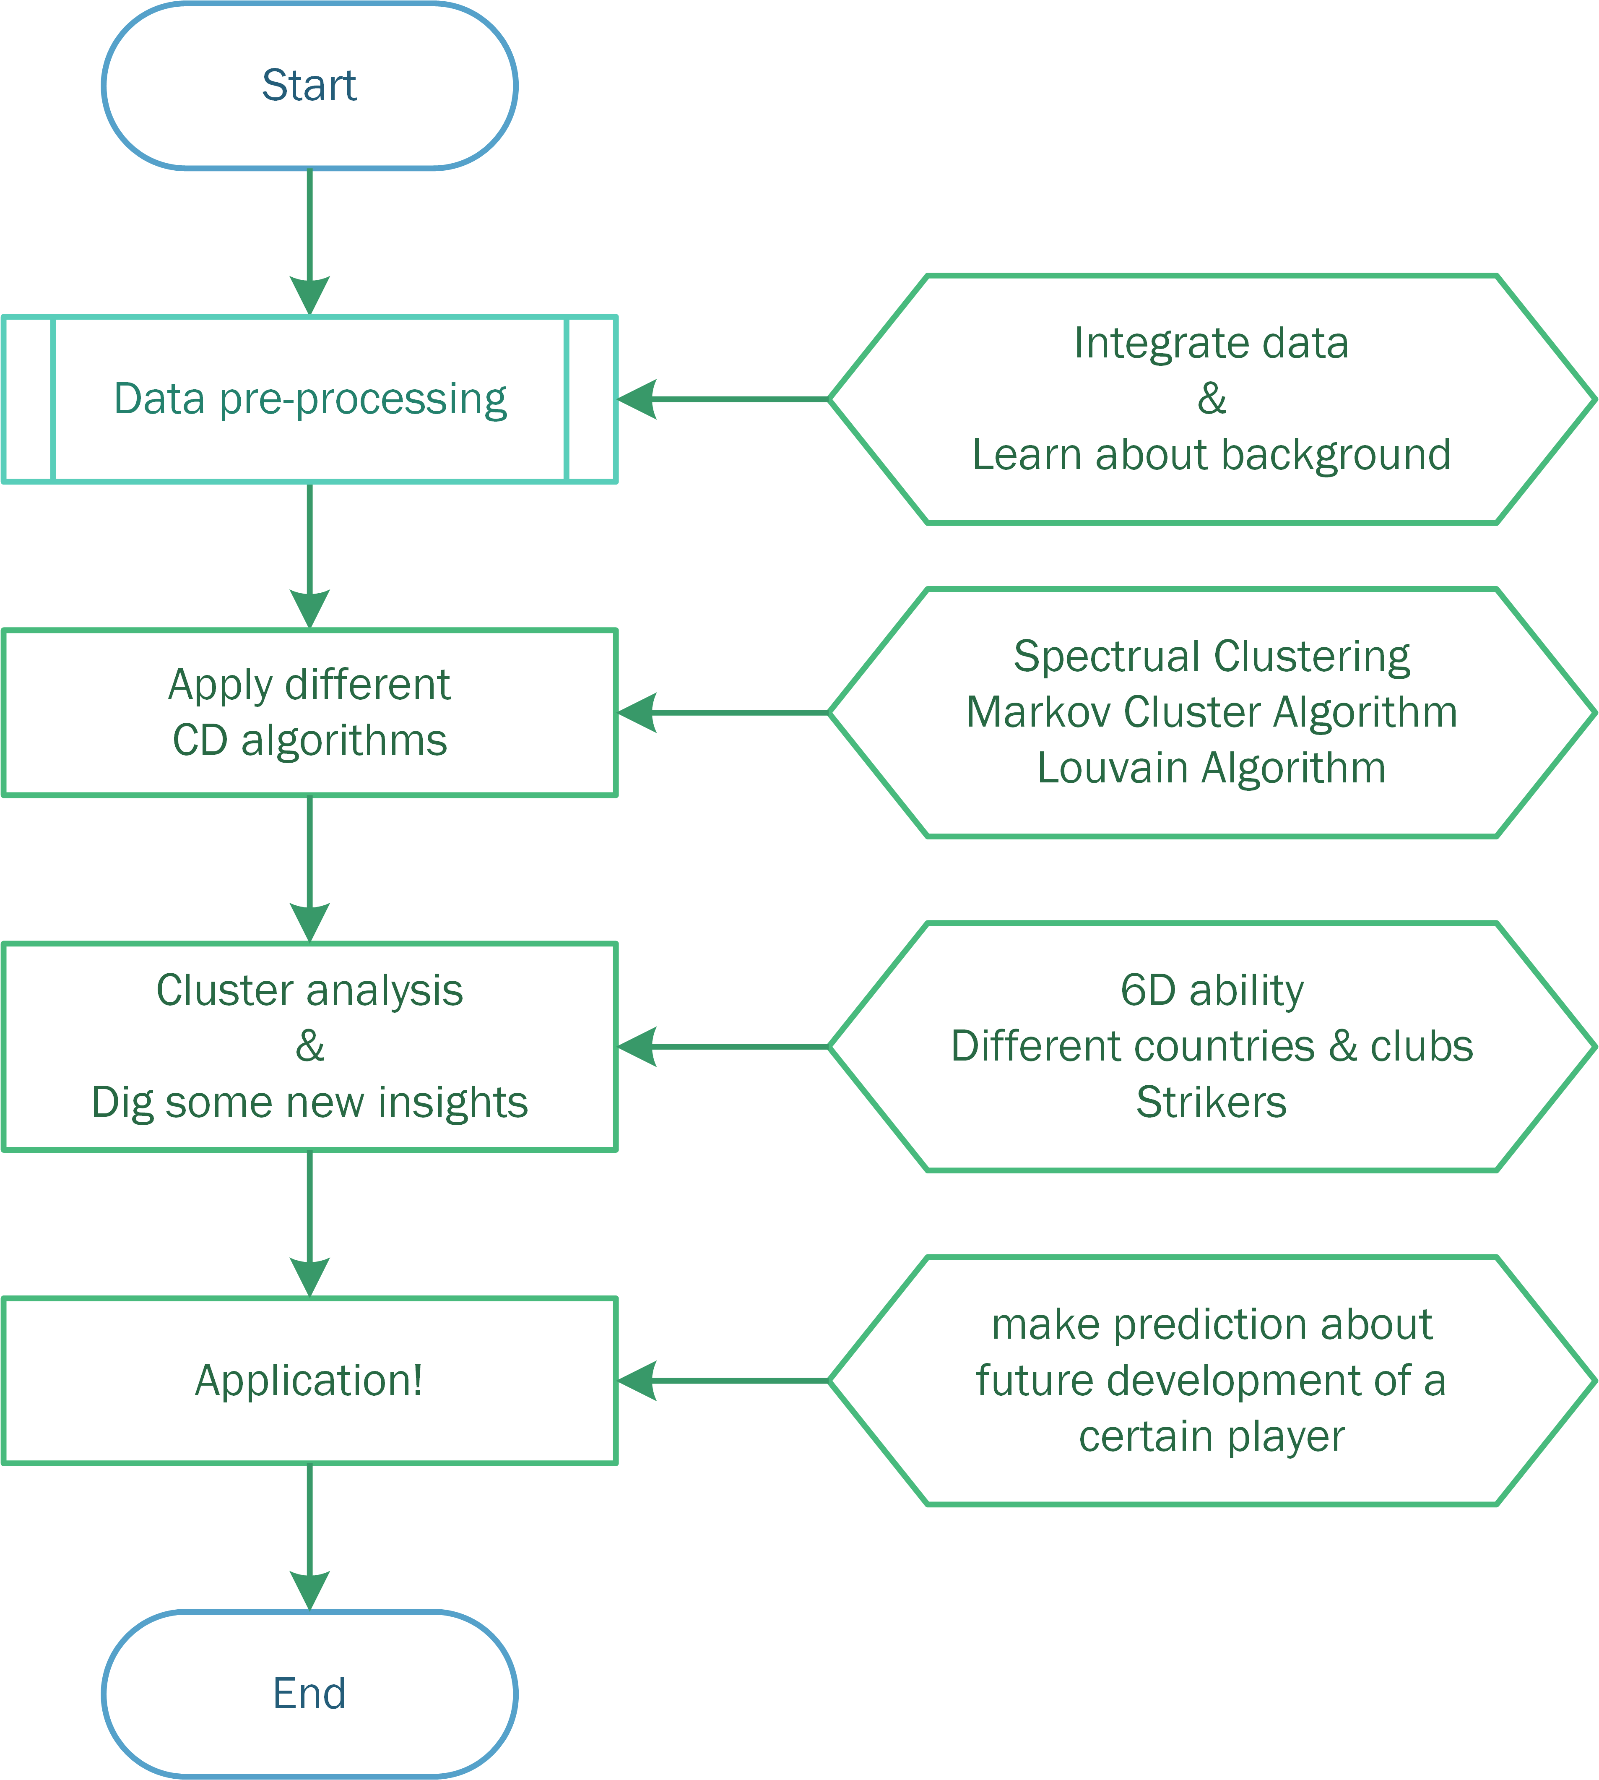
WORKFLOW

Slide 30
Thanks for listening!
Q&A
Football Player Management
Team 11

